Slide 1





Community Service Project
MENTOR TRAINING - DAY 5

Slide 2
Welcome | 15 | 135 | 9 am - 11:15 am
Warm up | 15
Recap | 15
Agenda | 5
Grouping Activity 1 - Sharing 3 case studies | 15
Map key stakeholders and Decide the research methodology to be use and design questions according | 30
Sharing their questionnaire | 45
Break | 15 | 15 | 11:15-11:30
Survey reporting - How to use tech to analyze data + How to analyze data with samples | 70 | 100 | 11:30 am - 1:10 pm
Activity to analyze data - drawing conclusions or next action items | 30
Lunch Break | 60 |  | 1:10pm - 2:10pm
Sharing analysis of data - within groups - Part 2 | 30 | 110 | 2:10 pm - 4:00 pm
Go through the findings of the case | 20
Warm up activity | 20-30
Role of a mentor - what student needs/ expectation and mentor interventions are required | 30

Slide 3
Break | 15 |  | 3:45pm - 4:00 pm
Group Sharing | 20 | 105 | 4:00 pm - 5:45 pm
Role of a mentor Log book introduction with grading | 10
Problem solving for challenges that can arise | 30
Recall | 20

Slide 4

Session 1
135 mins
Welcome
Warm up
Recap
Agenda
Design and Share survey questions

Slide 5

Welcome
Welcome to Day 5 of the Mentors Training Session
Reminder to fill in Day 4 feedback form
It’s lovely to see you all in person

Slide 6

Activity time
Make an aeroplane in 5 mins
Write your name on it
2 questions they want to ask someone they have just met.

Slide 7
Step 2
Form groups of 5
Stand in a circle
Throw the planes to another member in the circle
Ensure each member catches a plane
Once all the participants get the planes
One by one respond to the questions mentioned on the plane
10 mins respond
All must participate
Thank you

Slide 8


Recap (Respond through the chart paper)
1 thing you remember about Day 3 and Day 4
Write on a post-it each
Stick it on the respective chart papers
5 mins
Day 3
Day 4

Slide 9
Go through the responses
5 mins
Responses
Day 3
Day 4

Slide 10
Day 3
Why You and Why are you here?
Your Expectations of the program
8 weeks of the program for the students
Experience a section of the student curriculum
*Identifying issues around us through observation and experience
* Shortlisting problems
*Mapping it to SDGs
* Problem tree analysis, Framing the problem statement and research question
Introduction to who is a facilitator and some facilitator actions

Slide 11



Visualise
Community
College
Home

Slide 12
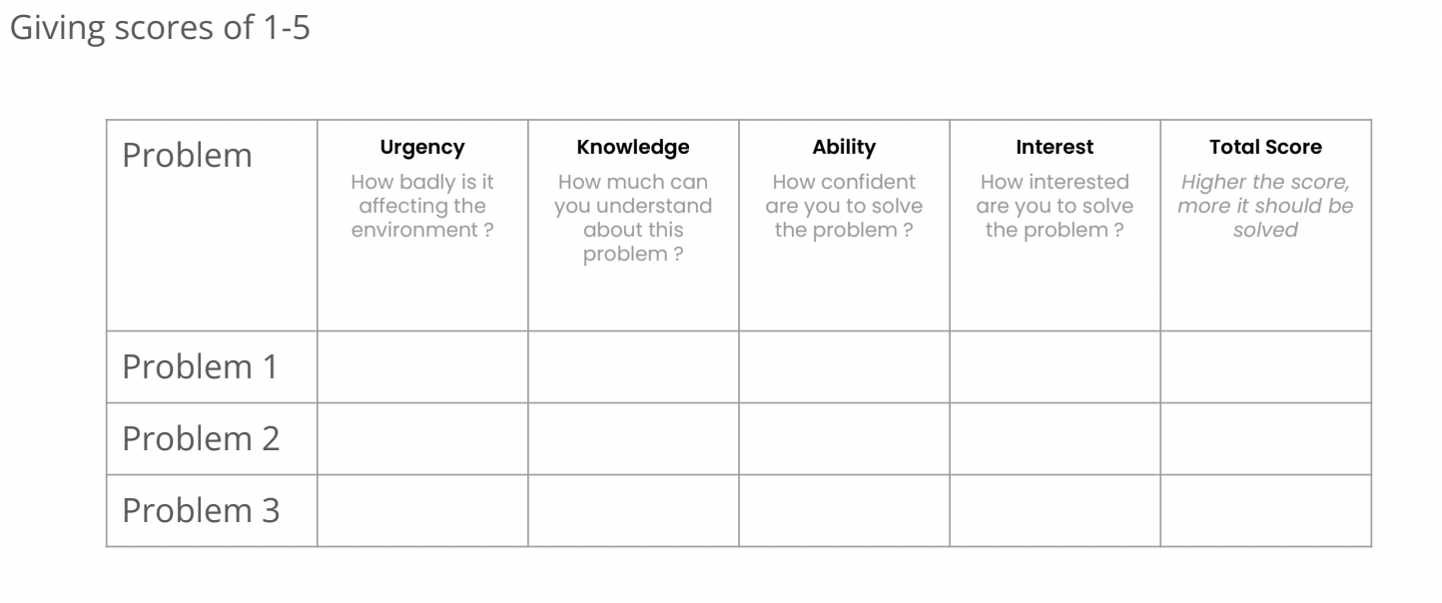
Score problems identified

Slide 13

4. Solutions (5 mins)
New leaf/ Additional branches
3. Effects (10 mins)
Branches
Identified Problem
Main Trunk
2. Causes (10 mins)
Roots
Problem Tree Analysis

Slide 14
Framing your problem statement
Causes+Effects+Users Affected= Problem Statement

Slide 15
Framing your research question
What is research question?
Answer: A question that addresses an issue or a problem which through analysis and interpretation of data, is answered in the study's conclusion. It is an important question as it sets foundation for research
What is the difference between research question and problem statement?
Answer: Merely explains the context of the problem with its causes and effects. However, Research question will help you research the problem and come to a conclusion. It is the basis for setting hypotheses and by the end of the research you either prove or disprove the hypothesis.

Slide 16
Day 4
Go through Second half of the week 1 curriculum
Types of Research & Survey Methods
Identifying Key Stakeholders for your survey
Introduction to tools for data collection
Identify key questions and tools for data collection
Facilitator Actions
Look at topics for Week 1 and 2 of student curriculum

Slide 17

Socio Economic Survey
A socio-economic survey is regarded as one of the most important sources of statistical data on household expenditure and income as well as other data on the status of housing, individual and household characteristics and living conditions.
Factors include: occupation, education, income, wealth and where someone lives
Socio-economic survey tools are designed to collect information as a means of improving understanding of local resource management systems, resource use and the relative importance of resources for households and villages
Students survey work will be accounted as socio-economic data to aid community development and growth.

Slide 18
Benefits of CBPR
Enhances community relevance of research questions
Facilitates effective
dissemination of findings to impact public health & policy
Strengthens interventions within cultural and local context
Enhances reliability/validity and of measurement tools
Increases accurate and culturally sensitive interpretation of findings
Increases research trust
1
2
3
4
5
6
It will be most beneficial if our students use this methodology for their project work for a buy-in from the community. To understand CBPR further - Let’slook at this video.

Slide 19
Students research method should be driven by their aims and priorities - they start by thinking carefully about what they want to achieve. When planning your their methods, there are two key decisions they will make.
A) Qualitative vs. quantitative:
Will your data take the form of words or numbers?
B) Primary vs. secondary:
Will you collect original data yourself, or will you use data that has already been collected by someone else?
C) Descriptive vs. experimental:
Will you take measurements of something as it is, or will you perform an experiment?
For quantitative data, you can use statistical analysis methods to test relationships between variables.
For qualitative data, you can use methods such as thematic analysis to interpret patterns and meanings in the data.
COLLECT DATA
ANALYSE

Slide 20

Quantitative
Qualitative
Qualitative research deals with words and meanings | . Quantitative research deals with numbers and statistics
Understand subjective experiences, beliefs, and concepts | Measure variables and describe frequencies, averages, and correlations
Gain in-depth knowledge of a specific context or culture | Test hypotheses about relationships between variables
Explore under-researched problems and generate new ideas | Test the effectiveness of a new treatment, program or product
NOTE
Both are important for gaining different kinds of knowledge.

Slide 21

Primary
Secondary
vs.
Original information that you collect for the purposes of answering your research question (e.g. through surveys, observations and experiments | Information that has already been collected by other researchers (e.g. in a government census or previous scientific studies).
If you are using a new research question, you need to collect primary data.
To synthesize existing knowledge, analyze historical trends, or identify patterns on a large scale, secondary data might be a better choice.
Usually, both can be combined as part of the research method. This is where getting the community involved will be helpful
NOTE

Slide 22
Descriptive
Experimental
vs.
In descriptive research, you collect data about your study subject without intervening. The validity of your research will depend on your sampling method. This includes observations, surveys, existing case studies etc | In experimental research, you systematically intervene in a process and measure the outcome. The validity of your research will depend on your experimental design. This includes experiments in the laboratory for example

Slide 23
Observations: Observing subjects in a natural environment where variables can’t be controlled.
Surveys: List of closed or multiple choice questions that is distributed to a sample (online, in person, or over the phone).
Quantitative data collection methods
Experiments: Situation in which variables are controlled and manipulated to establish cause-and-effect relationships.

Slide 24
Literature review:
Survey of published works by other authors.
Interviews:
Asking open-ended questions verbally to respondents. Key informant interviews can also be conducted: qualitative in-depth interviews with people who know what is going on in the community.
Qualitative data collection methods
Ethnography:
Participating in a community or organization for an extended period of time to closely observe culture and behavior.
Focus groups:
Discussion among a group of people about a topic to gather opinions that can be used for further research.

Slide 25
Survey Research
This project students are expected to do Surveys.
Survey research means collecting information about a group of people by asking them questions and analyzing the results. To conduct an effective survey, follow these four steps:
Determine who will participate in the survey - define population and sample
Decide the type of survey (In-person
or Online)
Design the survey questions and layout
Distribute the survey

Slide 26

Agenda
Case studies
Map the key stakeholders
Prepare a survey questionnaire based on the research methodology decided
Look at tools needed for data analysis for Survey reporting
How to analyze data and draw conclusions or next action items
Role of a mentor , requirements of students
Introduction to grading system and log book design
Problem solving mentor issues/challenges

Slide 27
Case studies
Session 1 - A case study and build on a research survey for the same
Form groups
3 types of case studies

Slide 28
Arts Students
Qualitative Focus Group Study
Topic: Employing CBPR to Understand the Well-Being of Higher Education Students During Covid-19 Lockdown in India
Task:
Design research survey questions for participants
What challenges did students face during this time?
Link to Case: https://drive.google.com/file/d/1KpHrty_Z5AV6kQYtgpIXD_bZ46bfwBgB/view?usp=sharing

Slide 29
Commerce Students
Type: Quantitative + Qualitative Study including Stakeholder Management
Topic: Tourism as an Additional Source of Rural Livelihoods: An Experience from Two Villages of Rajasthan
Task:
Design research survey questions for participants
Who are the key stakeholders for this study?
Link to Case: https://drive.google.com/file/d/1NkMC0uA2e75kx1vL6wRc-fISiVgY50GY/view?usp=sharing

Slide 30
Science Students
Type: Quantitative + Qualitative Study including educational intervention
Topic: The Effect of Community-Based Health Education Intervention on Management of Menstrual Hygiene among Rural Indian Adolescent Girls
Task:
Design research survey questions for participants
What education awareness campaign/strategy measures would you take?
Link to Case: https://drive.google.com/file/d/1bwAj8sA8D6_l4YOiq46d5N-mWcRXYwoa/view?usp=sharing

Slide 31

Choose your case study as a group

Slide 32
Design survey questions
Review this ‘Socio Economic Survey Sample’
You have two tasks
Design the survey/interview questions as per the case you have read so far ( come up with all the questions that you can think of)
Secondly do the task mentioned for your type of case study
You have 25 mins to complete it

Slide 33
Arts Students
Qualitative Focus Group Study
Topic: Employing CBPR to Understand the Well-Being of Higher Education Students During Covid-19 Lockdown in India
Task:
Design research survey questions for participants
What challenges did students face during this time?
Link to Case: https://drive.google.com/file/d/1KpHrty_Z5AV6kQYtgpIXD_bZ46bfwBgB/view?usp=sharing

Slide 34
Commerce Students
Type: Quantitative + Qualitative Study including Stakeholder Management
Topic: Tourism as an Additional Source of Rural Livelihoods: An Experience from Two Villages of Rajasthan
Task:
Design research survey questions for participants
Who are the key stakeholders for this study?
Link to Case: https://drive.google.com/file/d/1NkMC0uA2e75kx1vL6wRc-fISiVgY50GY/view?usp=sharing

Slide 35
Science Students
Type: Quantitative + Qualitative Study including educational intervention
Topic: The Effect of Community-Based Health Education Intervention on Management of Menstrual Hygiene among Rural Indian Adolescent Girls
Task:
Design research survey questions for participants
What education awareness campaign/strategy measures would you take?
Link to Case: https://drive.google.com/file/d/1bwAj8sA8D6_l4YOiq46d5N-mWcRXYwoa/view?usp=sharing

Slide 36

Group Sharing
Mention which case
Each group shares for 5 mins
Answer Task 1 - Questions that stood out
Answer Task 2

Slide 37

Thank you this was fun :)

Slide 38
Look at the type of questions that could be asked
Thank you for participating
Let’s look at some sample questions which could be asked for your type of case

Slide 39
Arts Students
Qualitative Focus Group Study
Topic: Employing CBPR to Understand the Well-Being of Higher Education Students During Covid-19 Lockdown in India
Task:
Design research survey questions for participants
What challenges did students face during this time?
Link to Case: https://drive.google.com/file/d/1KpHrty_Z5AV6kQYtgpIXD_bZ46bfwBgB/view?usp=sharing
Link to questionnaire: https://drive.google.com/file/d/1uxFq8NzvgCIiSGK9A-SJR6AJH7bIeCSO/view?usp=sharing

Slide 40
Commerce Students
Type: Quantitative + Qualitative Study including Stakeholder Management
Topic: Tourism as an Additional Source of Rural Livelihoods: An Experience from Two Villages of Rajasthan
Task:
Design research survey questions for participants
Who are the key stakeholders for this study?
Link to Case: https://drive.google.com/file/d/1NkMC0uA2e75kx1vL6wRc-fISiVgY50GY/view?usp=sharing
Link to questionnaire: https://drive.google.com/file/d/1vSkMxnaNPgB5rdXizjtNxMfyt-nrakL6/view?usp=sharing

Slide 41
Science Students
Type: Quantitative + Qualitative Study including educational intervention
Topic: The Effect of Community-Based Health Education Intervention on Management of Menstrual Hygiene among Rural Indian Adolescent Girls
Task:
Design research survey questions for participants
What education awareness campaign/strategy measures would you take?
Link to Case: https://drive.google.com/file/d/1bwAj8sA8D6_l4YOiq46d5N-mWcRXYwoa/view?usp=sharing
Link to Questionnaire: https://drive.google.com/file/d/1xvv-wtlx2QEFPw6C0UPTD9ycgNJoBUeT/view?usp=sharing

Slide 42
BREAK
15 MINS

Slide 43
Session 2
100 mins
How to use tech to analyze data
How to analyze data received
Drawing conclusions + check for hypothesis solutions + next action steps and report findings

Slide 44
Prepare Survey questions
Survey
Next??

Slide 45
Prepare Survey questions
Survey
Conduct the survey

Slide 46
Week 1 - Prepare Survey Questions + Methodology
Students Week 1- 2
Week 2 Conduct the survey

Slide 47
Analyse Data for Survey Reporting
Survey reporting
A survey report is a document with important metrics gathered from survey.. The goal of a survey report is to present the data in full, its analysis and presents all the results that were collected.
There are different methods and tools which we can use for analyzing data and reporting the survey
Help with next steps or conclusions and your findings

Slide 48
Different methods of Data Analysis
Research Method | Qualitative or Quantitative? | When to use?
Statistical Analysis | Quantitative | To analyze data collected in a statistically valid manner from surveys, and observations)
Thematic Analysis | Qualitative | To analyze data collected from interviews, focus groups or textual sources.

Slide 49
Statistical Analysis
Statistical analysis means investigating trends, patterns, and relationships using quantitative data. It is an important research tool used by scientists, governments, businesses, and other organizations.
Draw valid conclusions
Statistical analysis requires careful planning from the very start of the research process
You need to specify your hypotheses
Make decisions about your research design, sample size, and sampling procedure.
After collecting data from your sample, organize and summarize the data using descriptive statistics
Use inferential statistics to formally test hypotheses and make estimates about the population
Lastly interpret and generalize your findings.

Slide 50
5 step process for statistical analysis
Choose Sample and estimate sample size
Test hypotheses or make
estimates with inferential statistics
Write your hypotheses and plan your research design
Summarize your data with descriptive statistics
Interpret your results
1
2
3
4
5

Slide 51
STEP 1: Sample
Research Question | Hypothesis | Null Hypothesis
What are the health benefits of eating an apple everyday? | Increasing apple as part of every day diet will result in decreasing frequency of doctor visits | Increasing apple as part of every day diet will have no effect on frequency of doctor visits
Which mobile networks have the worst signal quality? | Low-cost mobile networks are more likely to have bad signal quality | Low-cost and high-cost mobile networks are equally likely to have bad signal quality

Slide 52
STEP 1: Write your hypotheses and plan your research design
The goal of research is often to investigate a relationship between variables within a population.
Begin with prediction, and use statistical analysis to test that prediction.
A statistical hypothesis is a formal way of writing a prediction about a population. Every research prediction is rephrased into null and alternative hypotheses that can be tested using sample data.
While the null hypothesis always predicts no effect or no relationship between variables, the alternative hypothesis states your research prediction of an effect or relationship.

Slide 53
Example:
Research Question:
Is there a relationship between parental income and college grade point average (GPA)?

Slide 54
What do you think will be the null hypothesis?

Slide 55
Null
Parental income and GPA have no relationship with each other in college students

Slide 56
What do you think will be the alternate hypothesis?

Slide 57
Alternate
Parental income and GPA are positively correlated in college students

Slide 58
Plan your research design
Research Design
Correlational design
Descriptive design
A research design is your overall strategy for data collection and analysis. It determines the statistical tests you can use to test your hypothesis later on.
You can explore relationships between variables (e.g., parental income and GPA) without any assumption of causality using correlation coefficients and significance tests.
You can study the characteristics of a population or phenomenon (e.g., the prevalence of self-confidence amongst college students in Andhra Pradesh) using statistical tests to draw inferences from sample data.
Example Research Design:
Null Hypothesis: To collect your data, you will ask participants to fill in a survey and self-report their parents’ incomes and their own GPA.

Slide 59
STEP 2: Choose Sample and estimate sample size
Decide on your sample size either by looking at other studies in your field or using statistics.
A sample that’s too small may be unrepresentative of the sample
A sample that’s too large will be expensive.
As a rule of thumb, a minimum of 30 units or more per subgroup is necessary
Sample size calculators online available for you to explore.

Slide 60
STEP 3: Summarize your data with descriptive statistics
There are 3 main types of descriptive statistics:
Distribution: the frequency of each value/variable in numbers or %
Measures of Central tendency: the averages of the values, the mean, median and mode are 3 ways of finding the average.
Mode: the most frequent value.
Median: the middle number in an ordered dataset.
Mean: the sum of all values divided by the total number of values.
Variability or dispersion: how spread out the values are - the range, standard deviation and variance each reflect different aspects of spread.
Range: the highest value minus the lowest value of the data set.
Interquartile range: the range of the middle half of the data set.
Standard deviation: the average distance between each value in your data set and the mean.
Variance: the square of the standard deviation.

Slide 61
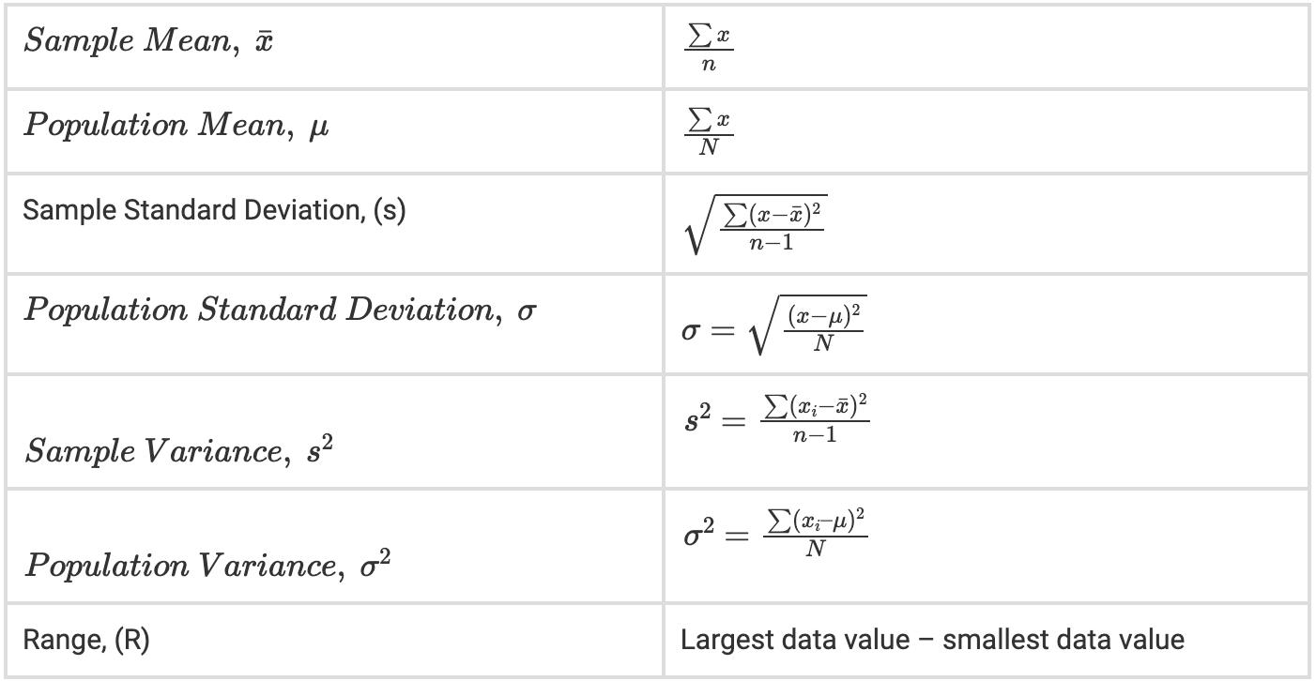
Summary of formulas required
for descriptive statistics

Slide 62
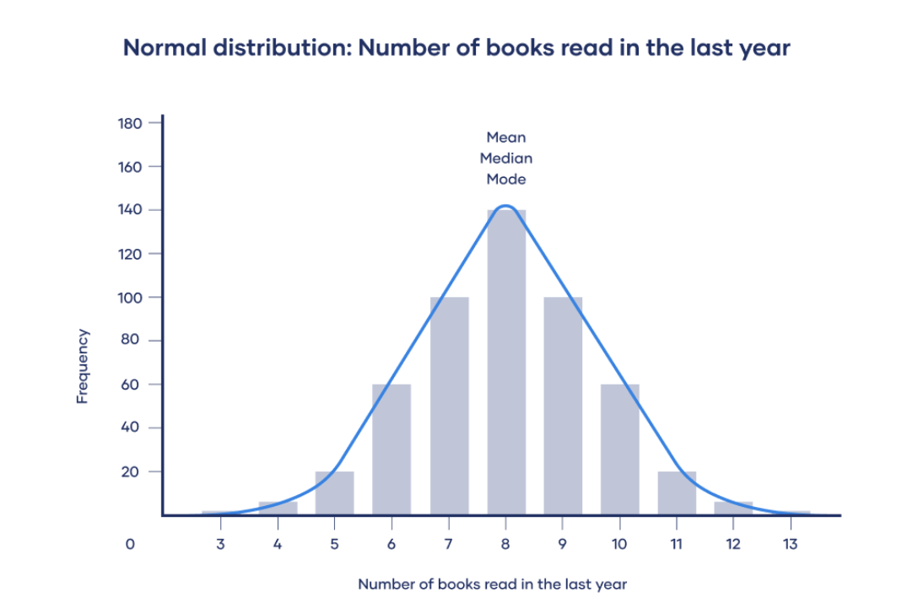
Types of distribution
In a normal distribution, data is symmetrically distributed with no skew. Most values cluster around a central region, with values tapering off as they go further away from the center. The mean, mode and median are exactly the same in a normal distribution.

Slide 63
Skewed Distribution: More values fall on one side of the center than the other, and the mean, median and mode all differ from each other. One side has a more spread out and longer tail with fewer scores at one end than the other. The direction of this tail tells you the side of the skew.

Slide 64
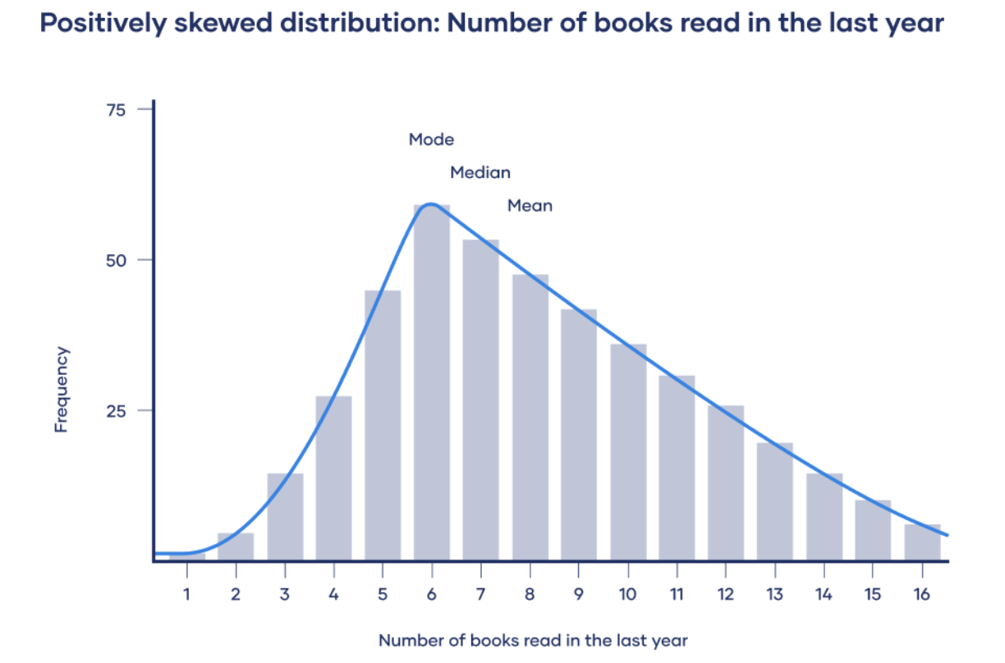
In a positively skewed distribution, there’s a cluster of lower scores and a spread out tail on the right. In a positively skewed distribution, mode < median < mean

Slide 65
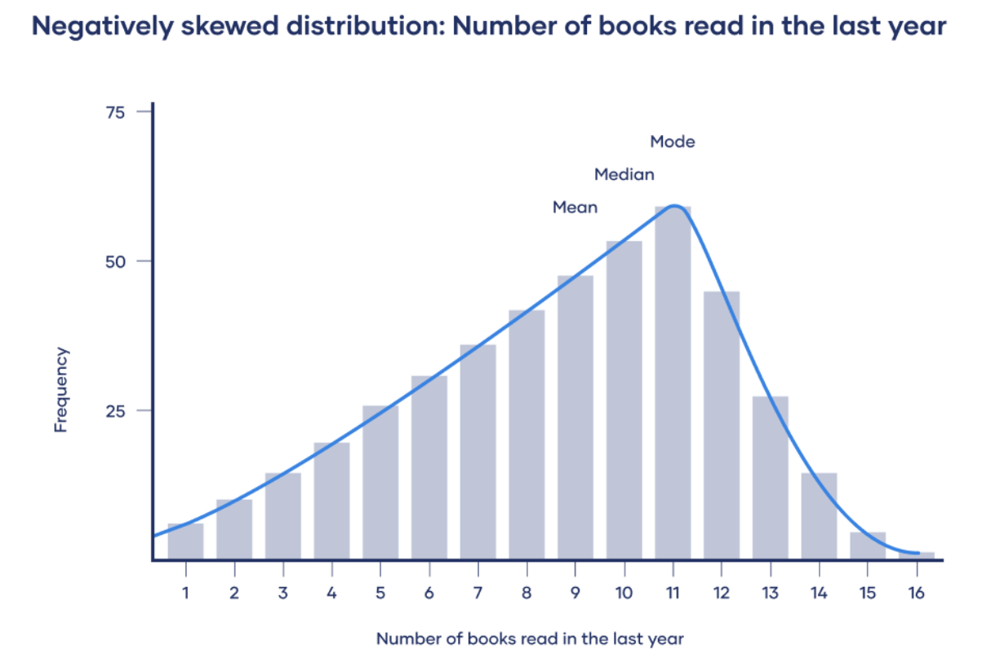
In a negatively skewed distribution, there’s a cluster of higher scores and a spread out tail on the left. In a negatively skewed distribution, mean < median < mode.

Slide 66
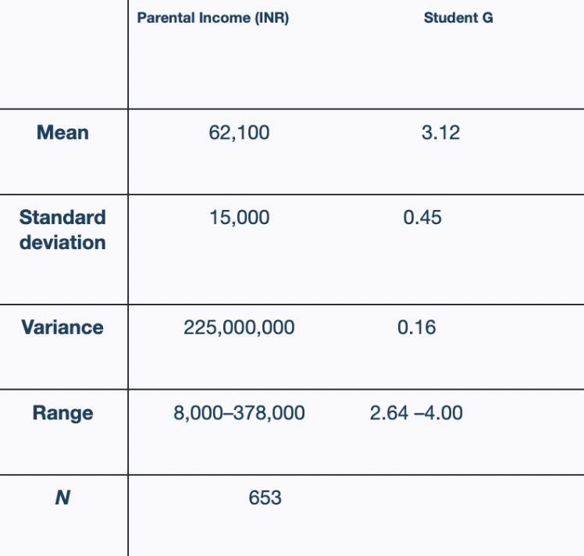
Example Descriptive Statistics:
After collecting data from 653 students, you tabulate descriptive statistics for annual parental income and GPA.
It’s important to check whether you have a broad range of data points. If you don’t, your data may be skewed towards some groups more than others (e.g., high academic achievers), and only limited inferences can be made about a relationship.
Next, we can compute a correlation coefficient and perform a statistical test to understand the significance of the relationship between the variables in the population.

Slide 67
STEP 4: Test hypotheses or make estimates with inferential statistics
Inferential statistics help you come to conclusions and make predictions based on your data.
Use random and unbiased sampling methods.
Using this method one can make conclusions about population parameters based on sample statistics.
A statistic is a measure that describes the sample (e.g., sample mean)
A parameter is a measure that describes the whole population (e.g., population mean)
Sampling error is the difference between a parameter and a corresponding statistic. Since in most cases you don’t know the real population parameter, you can use inferential statistics to estimate these parameters in a way that takes sampling error into account.

Slide 68
Two types of Estimates
Point Estimate
Interval Estimate
A point estimate is a single value estimate of a parameter. For instance, a sample mean is a point estimate of a population mean.
An interval estimate gives you a range of values where the parameter is expected to lie. A confidence interval is the most common type of interval estimate.

Slide 69
Both types of estimates are important for gathering a clear idea of where a parameter is likely to lie
A confidence interval uses the variability around a statistic to come up with an interval estimate for a parameter. Confidence intervals are useful for estimating parameters because they take sampling error into account.
A confidence level tells you the probability (in percentage) of the interval containing the parameter estimate if you repeat the study again.
A 95% confidence interval is usually used, you can use the same. It means that if you repeat your study with a new sample in exactly the same way 100 times, you can expect your estimate to lie within the specified range of values 95 times.

Slide 70
Hypothesis Testing
Test hypotheses about relationships between variables in the population
Hypothesis testing starts with the assumption that the null hypothesis is true in the population, and you use statistical tests to assess whether the null hypothesis can be rejected or not.
Statistical tests determine where your sample data would lie on an expected distribution of sample data if the null hypothesis were true. These tests give two main outputs:
A test statistic tells you how much your data differs from the null hypothesis of the test.
A p value tells you the likelihood of obtaining your results if the null hypothesis is actually true in the populat

Slide 71
Comparison tests: assess group differences in outcomes.
03
Correlation tests: assess relationships between variables without assuming causation.
01
02
Regression tests: assess cause-and-effect relationships between variables.

Slide 72
Introduction to t-test
A t-test is a statistical test that is used to compare the means of two groups.
Used in hypothesis testing
Determine whether a process or treatment actually has an effect on the population of interest, or whether two groups are different from one another.
When choosing a t-test, you will need to consider two things
whether the groups being compared come from a single population or two different populations
whether you want to test the difference in a specific direction.

Slide 73
One-sample, two-sample, or paired t-test?
One-tailed or two-tailed t-test?
If the groups come from a single population (e.g. measuring before and after an experimental treatment), perform a paired t-test.
If the groups come from two different populations (e.g. two different species, or people from two separate cities), perform a two-sample t-test (a.k.a. independent t-test).
If there is one group being compared against a standard value (e.g. comparing the acidity of a liquid to a neutral pH of 7), perform a one-sample t-test.
If you only care whether the two populations are different from one another, perform a two-tailed t-test.
If you want to know whether one population mean is greater than or less than the other, perform a one-tailed t-test.

Slide 74
Performing t-test
Excel is a great tool to perform the t-test, this link can be followed to understand and perform the step-by-step process - https://statisticsbyjim.com/hypothesis-testing/t-tests-excel/.
Additionally, you can google search for ‘how to perform t-tests on excel’ and learn from what suits you best.

Slide 75

Performing t-test
In this formula
t is the t-value, x1 and x2 are the means of the two groups being compared
s2 is the pooled standard error of the two groups
n1 and n2 are the number of observations in each of the groups.
Example: t-test Result
Since you expect a positive correlation between parental income and GPA, you use a one-sample, one-tailed t test. The t test gives you:
t value of 3.08 and a p value of 0.001

Slide 76
A larger t-value shows that the difference between group means is greater than the pooled standard error, indicating a more significant difference between the groups.

Slide 77
STEP 5: Interpret your results
Statistical significance - The significance level, or alpha (α), is a value that the researcher sets in advance as the threshold for statistical significance. In a hypothesis test, the p value is compared to the significance level to decide whether to reject the null hypothesis.
If the p value is higher than the significance level, the null hypothesis is not rejected, and the results are not statistically significant.
If the p value is lower than the significance level, the results are interpreted as rejecting the null hypothesis and reported as statistically significant.
Usually, the significance level is set to 0.05 or 5%. That means your results must have a 5% or lower chance of occurring

Slide 78
Note: Statistically significant results are considered unlikely to have arisen solely due to chance. There is only a very low chance of such a result occurring if the null hypothesis is true in the population.
Example: Result Interpretations
You compare your p value of 0.001 to your significance threshold of 0.05. With a p value under this threshold, you can reject the null hypothesis. This indicates a statistically significant correlation between parental income and GPA in college students.
Note that correlation doesn’t always mean causation, because there are often many underlying factors contributing to a complex variable like GPA. Even if one variable is related to another, this may be because of a third variable influencing both of them, or indirect links between the two variables.

Slide 79
Thematic Analysis
Find about people’s views, opinions, knowledge, experiences or values by analyzing qualitative data.
Applied to a set of texts from surveys, interviews or focus groups.
Examined the data to identify common themes – topics, ideas and patterns that come up repeatedly.
It is subjective
Relies on the researcher’s judgement and choice
Some types of research questions you can use thematic analysis to answer:
How do patients perceive doctors in a government hospital?
What are young women’s experiences about inequality in their daily life?
How is the support system for financial assistance from banks?

Slide 80
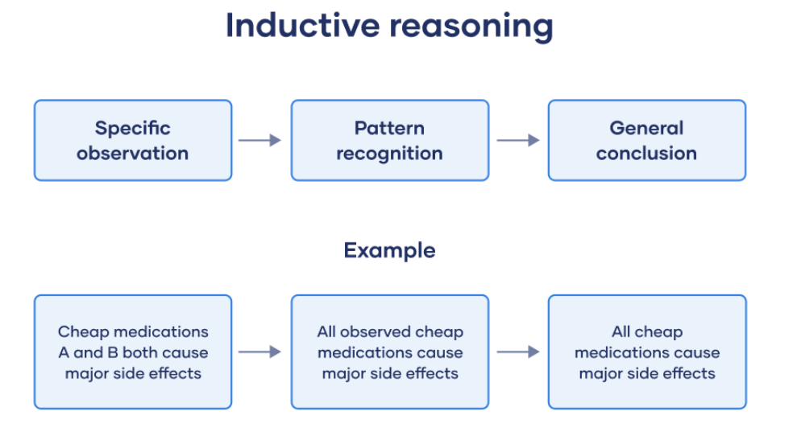
Two types of approaches for thematic Analysis
Inductive Approach
Method of drawing conclusions by going from the specific to the general or bottom-up reasoning
Logical approach to making inferences, or conclusions
People often use inductive reasoning informally in everyday situations.

Slide 81
Example
Stage | Example 1 | Example 2
Specific Observation | Charlie is a brown dog and he barks loudly | Baby Riya said her first word at the age of 12 months
Pattern Recognition | Every brown dog I met barks loudly | Every girl baby I saw says their first word at 12 months
General Conclusion | All brown dogs bark loudly | All girl babies say their first word at the age of 12 months

Slide 82
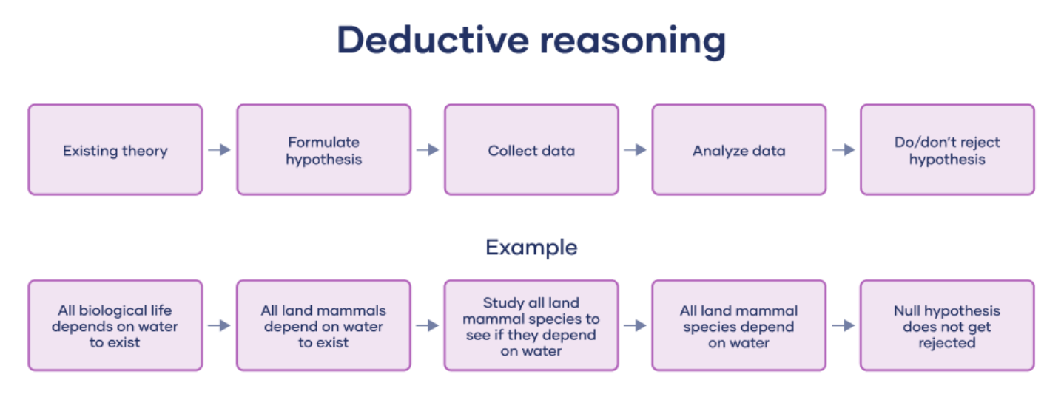
Two types of approaches for thematic Analysis
2. Deductive Approach
Method where you progress from general ideas to specific conclusions or top-down reasoning.
In deductive reasoning, you’ll make an argument for a certain idea.
You make an inference, or come to a conclusion, by applying different premises.

Slide 83
Example
Stage | Example 1 | Example 2
Premise | All insects have exactly 6 legs | Blue Litmus paper turns red in the presence of acid
Premise | Spiders have eight legs | The blue litmus paper turned red when I poured some liquid on it
Conclusion | Therefore, spiders are not insects | Therefore, the liquid is acidic

Slide 84
Thematic Analysis
Familiarization
Coding
Generating Themes
Reviewing Themes
Defining and Naming themes
Summary

Slide 85
Step 1 - Familiarization
The first step is to get to know our data
Get a thorough overview of all the data we collected before we start analyzing individual items.
This can involve transcribing audio, reading through the text and taking initial notes, and generally looking through the data to get familiar with it.

Slide 86
Step 2 - Coding
Highlighting sections of our text – usually phrases or sentences – and coming up with shorthand labels or “codes” to describe their content.
Let’s take a short example text. Say we’re researching perceptions of safety in online payments (UPI, Netbanking) among participants aged 50+. We have collected data through a series of interviews. An extract from one interview looks like this:
Interview Extract | Codes
Personally, I’m not sure. I think many people are using it, but I don’t know why or how. People say you should trust the system and it’s safe, but what if they have hidden benefits in this? I’m not saying they’re wrong, I’m just saying there’s reasons not to 100% trust them. The rules keep changing – I can’t do any transactions outside banks. | Uncertainty Acknowledgement and awareness Lack of trust in system Difficult to accept change

Slide 87
Step 3 - Generating Themes
Look at the codes
Identify patterns
Generate themes
Combine several codes to create a theme
Codes which are vague or not relevant can be grouped
From the previous example
Codes | Theme
Uncertainty Lack of knowledge Alternative explanations | Uncertainty
Fear of being cheated by system Lack of trust in system Distrust of technology | Lack of trust in system

Slide 88
Step 4 - Reviewing Themes
Ensure themes are useful and accurate representations of the data
Review data set and compare the themes
Check if you are missing anything?
Are the themes really present in the data?
What can you change to make the themes work better?

Slide 89
Step 5 - Defining and Naming Themes
Name each theme and define them
Defining themes involves formulating exactly what you mean by each theme
Figuring out how it helps you understand the data.
Naming themes involves coming up with a succinct and easily understandable name for each theme.

Slide 90
Summary
Synthesise your analysis of the data
Follow the report format provided
Include a methodology section
Describing how you collected the data (e.g. through structured interviews or open-ended survey questions or focus groups
Explain how you conducted the thematic analysis itself
The results or findings section usually addresses each theme in turn
Describe how often the themes come up and what they mean, including examples from the data as evidence
In the conclusion explain the main takeaways and show how the analysis has answered the research question.

Slide 91
Drawing Conclusions and Next Steps
Spend the First 10 mins looking at the stakeholders identified, survey conducted and the data collected during the survey
Next look at the tools used to collect data and for analysis
Analyze the data
State your findings and what the next steps should be
Do not look at the conclusion part

Slide 92
BREAK
60 MINS

Slide 93
Session 3
90 mins
Warm Up
Group Sharing

Slide 94

Group Sharing
Your findings and what steps should be taken next
Add in any other points you found interesting or struck you
5 mins per team

Slide 95
Look at the CASE Studies
10 mins to go through the final conclusions of the case study
Discuss on the below
What are some similarities and differences between the actual findings and the one you made as a group

Slide 96
How was it working with a group live?
How did you feel doing this activity?
What are somethings that stood out for you

Slide 97

Students will get an opportunity to go through these surveys in their student curriculum and go through a similar process of learning individually
NOTE
This is the completion of week 1 and 2 for the students.

Slide 98

Activity Time
I have a challenge for you all!
The goal of this activity is to bring this pipe down from the shoulder length of the tallest person in the group to the ground
Guideline:
  The pipe must only rest on your index fingers
  Your index fingers should only be parallel. Not up-down- facing down or up, and neither should you hold the pipe at any point
  The pipe must stay in contact with index fingers of ALL the members ALL the time till the task is delivered.
  Every time you digress or catch yourself from not following the guidelines: “you start the task again..”
Expectation: “I expect you to correct yourself without me calling out..”
Time: 7 mins
Do you have any questions about this challenge?

Slide 99
How was the experience?
.What did you personally have to do to make sure the pipe did not drop?
What did you need the others to do?
Each of us have a role to play and the program will not go forward without your complete cooperation, coordination and help. You all play a very important role.

Slide 100
Mentors
Each mentor gets 10-15 mentees
Students update and seek guidance from mentors for the project

Slide 101

Support Student Needs | Mentor Actions to support

Slide 102
BREAK
15 MINS

Slide 103
Session 4
105 mins
Participants will be able to identify issues or challenges that could come up
Share solutions for the problems or challenges
Understand the log book and grading

Slide 104
Group sharing
Top 3 needs students will have
Need 1
Mentor Action
Need 2
Mentor Action
Need 3
Mentor Action

Slide 105
Role of a mentor
Assigned with 10 to 15 students
Faculty-mentor for the group
In-charge for the learning activities of the students
Comprehensive and continuous assessment of the students.
Meet the students before they begin their projects
Handover the student curriculum and the log book template
Be available on calls for the students to ask questions/doubts
Meet them mid project to see progress
Check on log completions
Approve project completion
Grade the project

Slide 106
Grading the project
Learning outcomes:
To facilitate an understanding of the issues that confronts the vulnerable / marginalized sections of the society.
To initiate team processes with the student groups for societal change.
To provide students an opportunity to familiarize themselves with urban / rural community they live in.
To enable students to engage in the development of the community.
To plan activities based on the focused groups.
To know the ways of transforming the society through systematic programme implementation.
The following is the evaluation methodology for awarding marks/grades.
There will be only internal evaluation for this internship.

Slide 107

The assessment is to be conducted for 100 marks.
The number of credits assigned is 4.
Later as per the present practice the marks are converted into grades and grade points to include finally in the SGPA and CGPA.
The weightings shall be:
Project Log 20%
Project Implementation 30%
Project report 25%,
Presentation 25%

Slide 108
Log Book
Each student is required to maintain an individual logbook
Supposed to record day to day/ weekly.
The project log is assessed on an individual basis, thus allowing for individual members within groups to be assessed this way. The assessment will take into consideration the individual student’s involvement in the assigned work. ( Incase it is a group project)
While grading the student’s performance, using the student’s project log, the following should be taken into account -
a. The individual student’s effort and commitment.
b. The originality and quality of the work produced by the individual student.
c. The student’s integration and co-operation with the work assigned.
d. The completeness of the logbook.

Slide 109
Log Book
Students will maintain two types of log
Daily log ( which will be filled with basic details of their day to day project activities)
Milestone log - which will appear in between the chapters for them to fill in

Slide 110
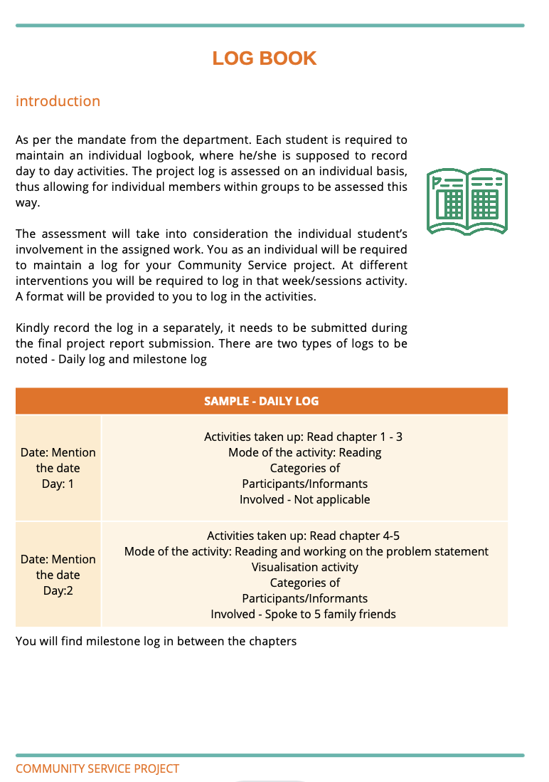
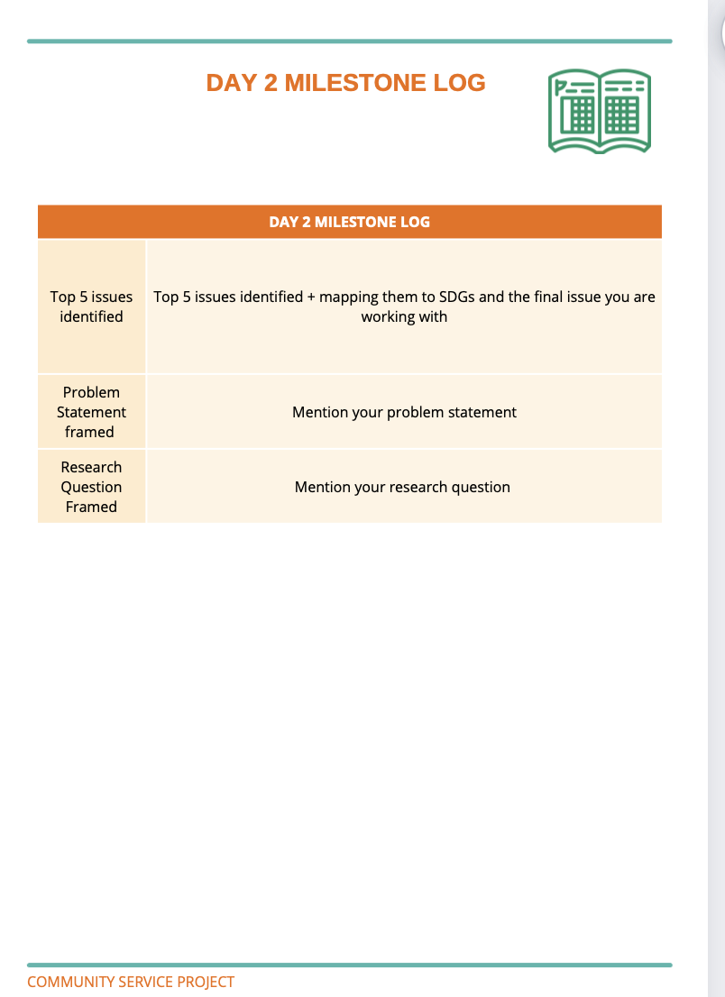
Log Book

Slide 111
The assessment for the Community Service Project implementation shall
include the following components and based on the entries of Project Log and
Project Report:
a. Orientation to the community development
b. Conducting a baseline assessment of development needs
c. Number and Quality of Awareness Programmes organised on beneficiary programmes and improvement in quality of life, environment and social consciousness, motivation and leadership, personality development, etc.
d. Number and Quality of Intervention Programmes (Prevention or promotion programs that aim to promote behavioural change in defined community contexts to address social problems) organised.
e. Follow-up Programmes suggested (Referral Services, Bringing Community
Participation)
f. Developing short and mid-term action plans in consultation with local leadership and local government officers.

Slide 112
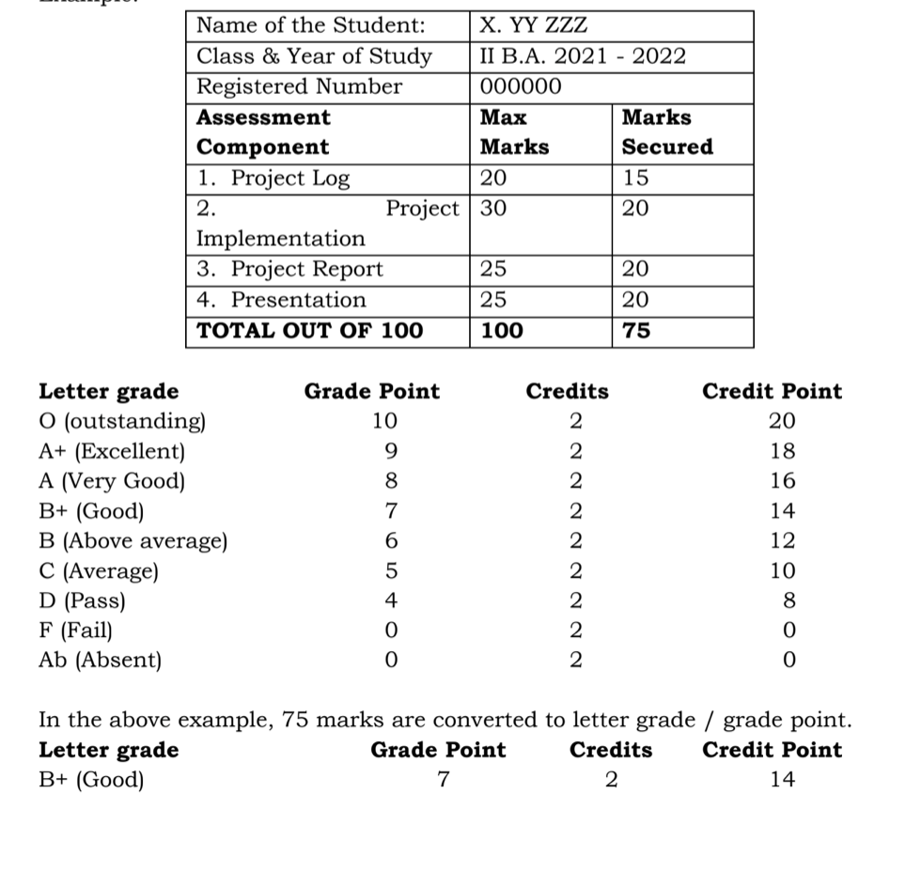
The Project Report shall be prepared as per the guidelines given in the Model
Project Report.
The Project Presentation is to be made by the student after he/she reports
back to the College. The components for assessment are –
a. assessing the involvement in the project
b. presentation skills
c. final outcome of the project as evinced by the student.
Example:

Slide 113
CSP Assessment Methodology for Mentor
The assessment is to be conducted for 100 marks. The number of credits assigned is 4. Later as per the present practice the marks are converted into grades and grade points to include finally in the SGPA and CGPA.
The weightings shall be:

Slide 114
Project Log - 20%
Each student is required to maintain an individual logbook, where he/she is supposed to record day to day activities. The project log is assessed on an individual basis, thus allowing for individual members within groups to be assessed this way. The assessment will take into consideration the individual student’s involvement in the assigned work.
Project Log Assessment - 20 marks
Log Book filled everyday | Accuracy of Logging | Originality | Overall Quality & Effort | Total
/5 | /5 | /5 | /5 | /20

Slide 115
Project Implementation -30%
Project Implementation Assessment - 30 marks
Focus on Community Issues | Quality of Socio Economic Survey | Quality of Awareness Programs (Min. 1) | Quality of Intervention Programs (Min. 1) | Quality of Solutions & Action Plan | Overall Quality & Effort | Total
/5 | /5 | /5 | /5 | /5 | /5 | /30

Slide 116
Project report -25%
The Project Report shall be prepared as per the guidelines given in the Model Project Report.
Project Report Assessment - 25 marks
Adherence to Model Report | Grammar & Formatting | Presentation | Project Conclusion & Effectiveness | Overall Quality & Effort | Total
/5 | /5 | /5 | /5 | /5 | /25

Slide 117
Presentation -25%
The Project Presentation is to be made by the student after he/she reports back to the College
Project Presentation Assessment - 25 marks
Creativity | Quality of Slides & Content | Presentation | Answering Questions | Overall Quality & Effort | Total
/5 | /5 | /5 | /5 | /5 | /25

Slide 118
Problem Solving
45 MINS

Slide 119
Problems Faced
Mentors
Students

Slide 120
Role of a mentor
Assigned with 10 to 15 students
Faculty-mentor for the group
In-charge for the learning activities of the students
Comprehensive and continuous assessment of the students.
Meet the students before they begin their projects
Handover the student curriculum and the log book template
Be available on calls for the students to ask questions/doubts
Meet them mid project to see progress
Check on log completions
Approve project completion
Grade the project

Slide 121


Mentor Challenges
Solutions

Slide 122
Student Challenges
Solutions

Slide 123
Sharing

Slide 124
Recall
Case studies
Map the key stakeholders
Prepare a survey questionnaire based on the research methodology decided
Look at tools needed for data analysis for Survey reporting
How to analyze data and draw conclusions or next action items
Role of a mentor , requirements of students
Introduction to grading system and log book design
Problem solving mentor and student issues/challenges

Slide 125
Closing
Poll: Energy level rate from 1-5, 1 being low and 5 being high
Feedback form:

Slide 126
QnA
10 MINS

Slide 127
See You next session

